Slide 1
Build a web part powered by the graph API
Austin Breslin
@austinbreslindev

Slide 2
Setup of Permissions

Slide 3
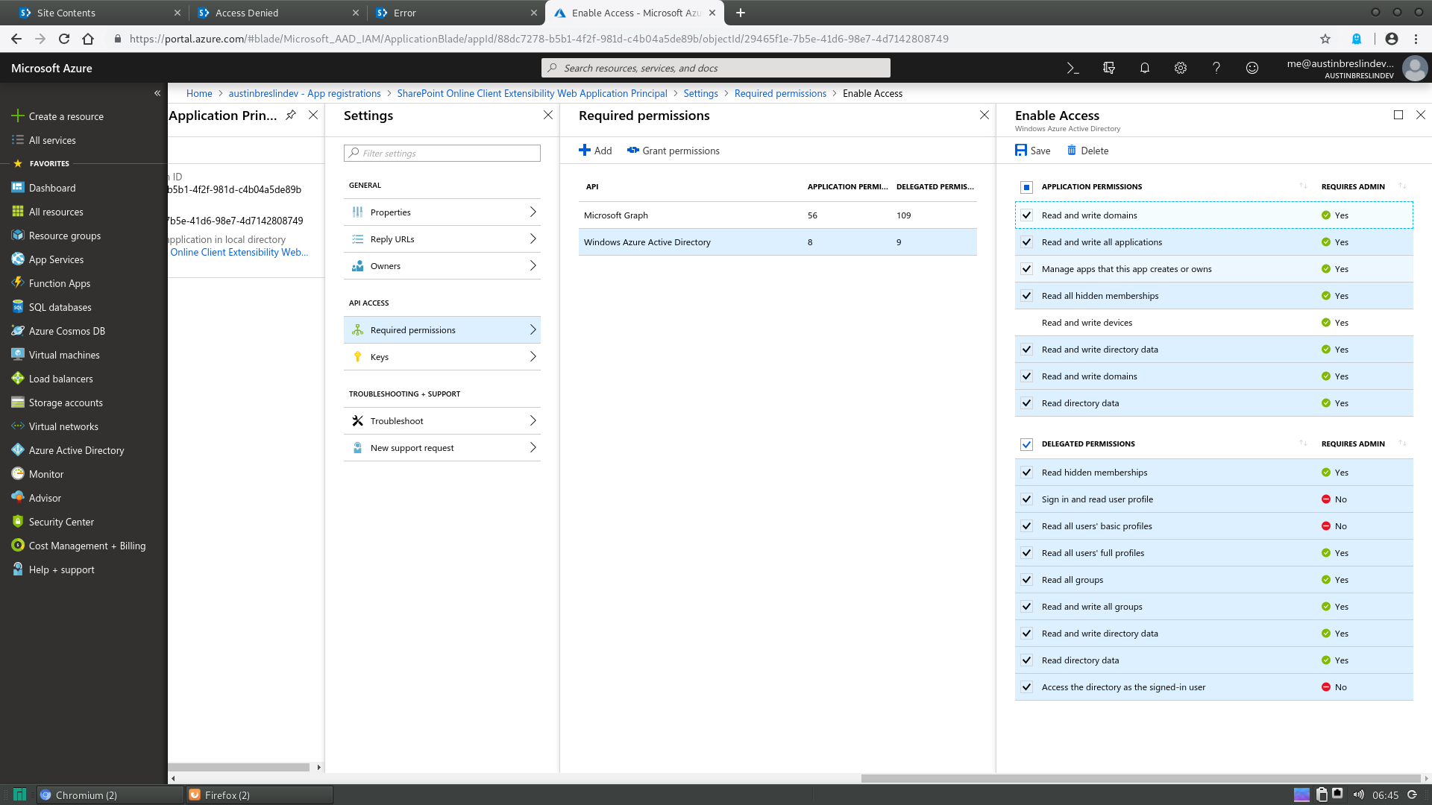
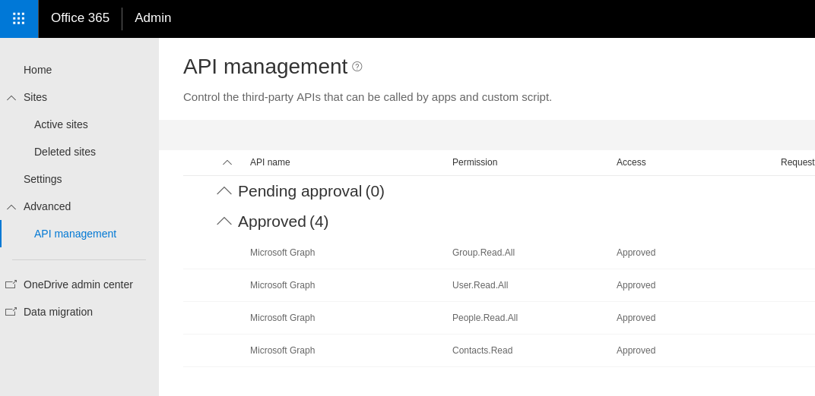
Permissions within SharePoint and Azure Active Directory
To use the MS Graph Rest API within a WebPart you need to grant permission.
The SharePoint Admin Panel
Azure Active Directory App Registrations

Slide 4
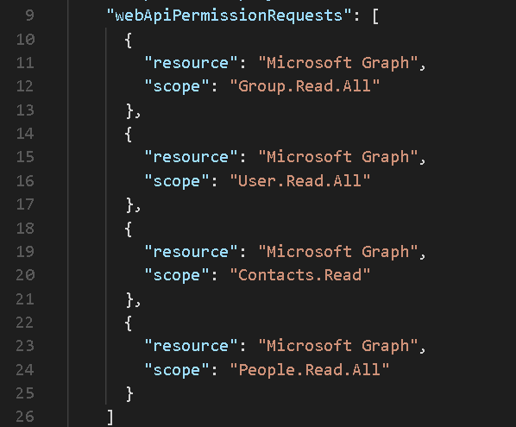
Permissions Requesting within the WebPart
In the package-solution.json is where you request your permissions.
X.ReadWrite.X for Read & Write and X.Read.X for Read only.
[Type].[Permission].[Amount]

Slide 5
Using/Discovery of MS Graph Rest API

Slide 6
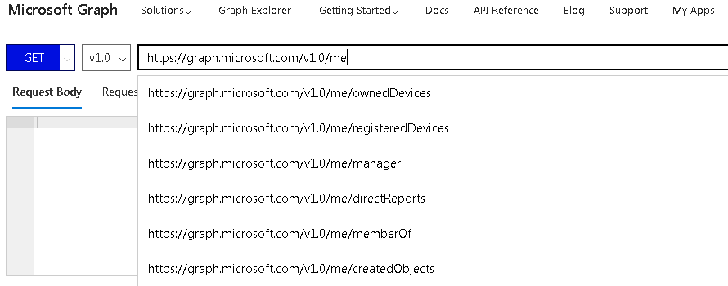
Graph Explorer & API Documentation
With the Graph Explorer you can discover and see the HTTP Request/Responses to discover.
With the API Documentation, you can get in depth knowledge about each piece.

Slide 7
Using Graph With SPFx 1.6.0

Slide 8
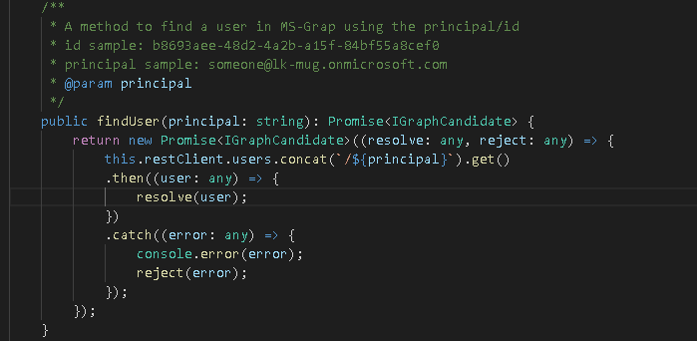
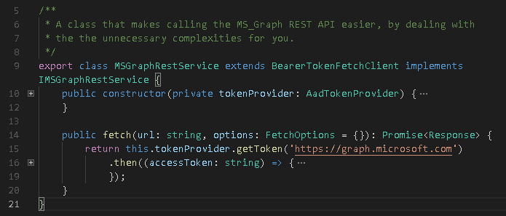
PNP JS @pnp/graph
@pnp/graph provides you with a fluent API and simple way to use MS Graph within your WebPart
Just authenticate and create a service which is provided for you in the repo.

Slide 9
References
@pnp/graph documentation: https://pnp.github.io/pnpjs/graph/docs/
Graph Explorer: https://developer.microsoft.com/en-us/graph/graph-explorer
Graph API: https://developer.microsoft.com/en-us/graph/docs/concepts/v1-overview

Slide 10

Next up: OfficeDevPnP PowerShell and PnP Provision Engine

